Slide 1
VSEPR
Valence shell electron pair repulsion (VSEPR) theory is used to predict the shape of a model by examining the Lewis Dot structure

Slide 2
The shape of a molecule is determined by the valence electrons and the bonds surrounding the central atom

Slide 3
To predict the molecular shape of an atom:
Draw the Lewis Dot structure
Locate all bonds and lone pairs around the central atom
Apply VSEPR theory: try to find a shape that allows the shared and unshared electrons to be as far away from each other as possible

Slide 4
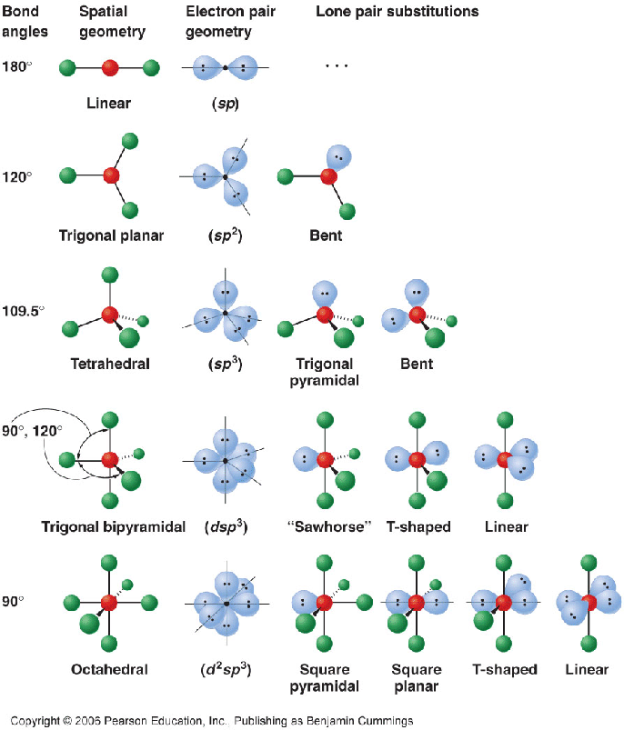
Some common shapes
Notes:
Each one has a shape
A certain angle size

